Slide 1
Key Partners
Payment Processors
Insurance Companies
Marketing Partners
Local Businesses
Technology Providers
Biz travel managers
Tourism Partners
Superhosts
Insurances
Investors
Experienced Hosts
Key Activities
Platform Development and Maintenance
Marketing and customer acquisition
Contetnt Creation and curation
Community management
Payment Processing and Security
Minimize Risk
New offers
Value Propositions
For Hosts
Income generation
Ease of getting started
Good, screened guests
Management tools
Extensive resources
For guest
Choice & variation
Amenities
Best value
Authentic stay
Local Experience
For both
Customer Relationships
Online self-service
Customer Support
Community Forum
For Hosts
Safety/security
Supports
Issue management
To communities
Good neighbour
Good citizen
Customer Segments
Hosts
Maximisers
Opportunity seekers
Guests
Higher education
Higher income
30-49 years old
Business travel
Luxury travel
Key Resources
The Airbnb platform
User Data
Brand Reputation
Content
Payment Processing Systems
Active hosts
Brand
Algorithm
Acquisitions
Hosts and Guests
Channels
Website and mobile app
Marketing channels
Referral programs
Social media
Word-of-mouth
Discounts/Promo
Referrals
Host/Guest
Cost Structure
Marketing and Customer acquisition
Payment processing fees
Customer support
Content creation and curation
Technology and infrastructure
Cost of Revenue
Insurance, Payment Processing, IT infrastructure
Customer Acquisition, discounts, promos, referrals, associates
Revenue Streams
Host fees
Guest fees
Experience fees
Premium listings
Commissiona of transaction value

Slide 2
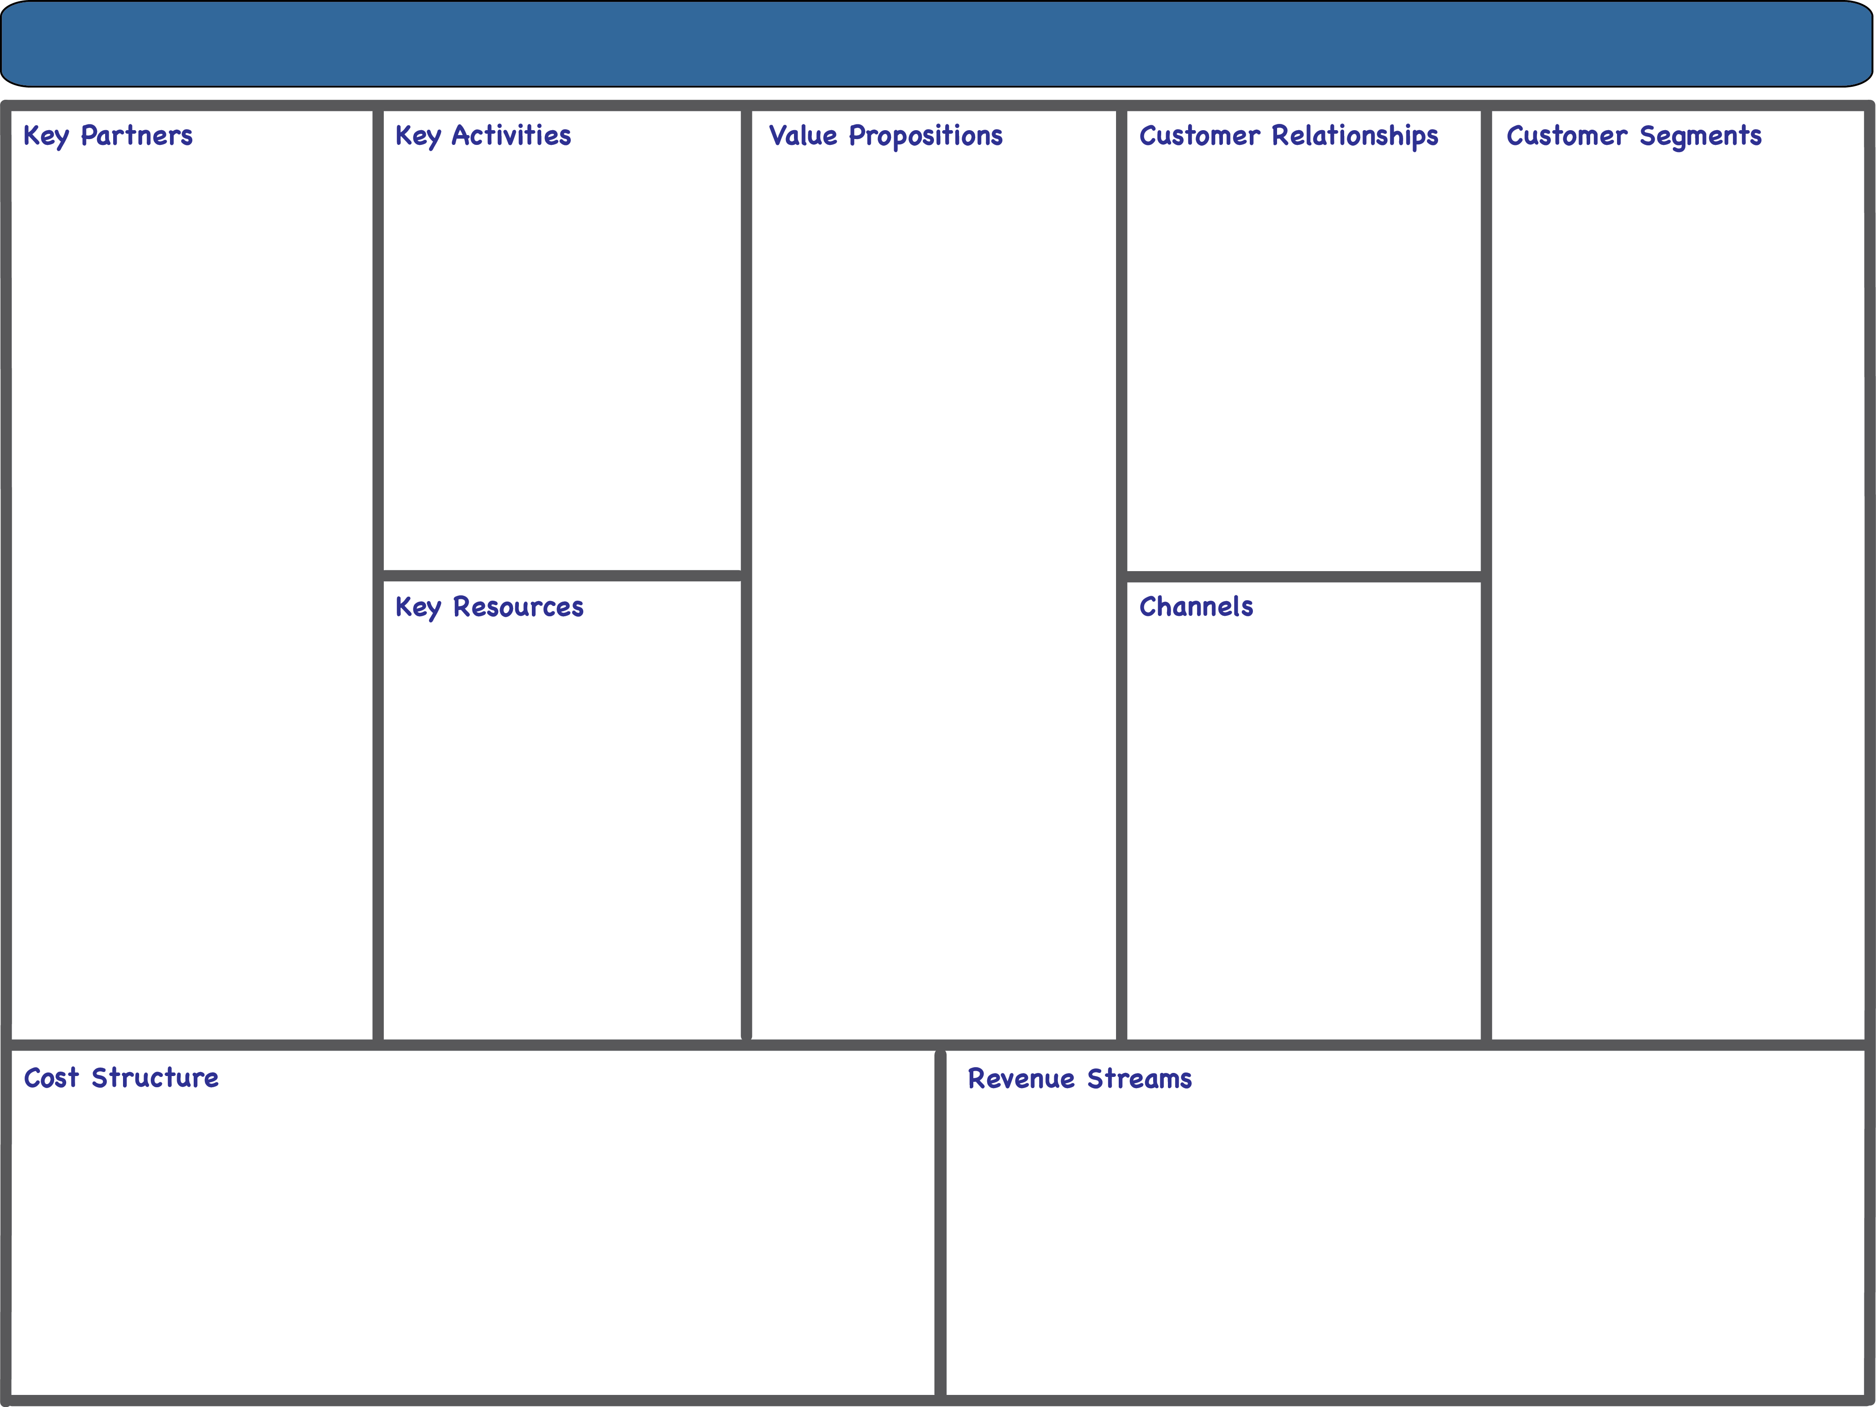








Airbnb Business Model Canvas
Payment Processors
Insurance Companies
Marketing Partners
Local Businesses
Technology Providers
Business Travel Managers
Tourism Partners
Superhosts
Experienced Hosts
Investors
Commercial Partners
Platform Development and Maintenance
Marketing and Customer Acquisition
Content Creation and Curation
Community Management
Payment Processing and Security
Minimize Risk
Consistent Guest Experiences
For Hosts:
Income Generation
Ease of Getting Started
Good, Screened Guests
Management Tools
For Guests
Choice & Variation
Amenities
Best Value
Authentic Stay
Local Experience
For All
Risk Minimization
Ease of Transactions
Online Self-Service
Customer Support
Community Forum
Safety/Security Measures
Issue Management
Hosts:
Maximizers
Opportunity Seekers
Guests:
Higher Education
Higher Income
30-49 Years Old
Business Travelers
Luxury Travelers
Leisure Travelers (Single vs. Family)
Business Travelers (Short vs. Long Term)
Website and Mobile App
Marketing Channels
Referral Programs
Social Media
Word-of-Mouth
Discounts/Promotions
Host/Guest Interactions
Key Resources
Airbnb Platform
User Data
Brand Reputation
Content
Payment Processing Systems
Active Hosts and Guests
Algorithm
Skilled Staff
Acquisitions
Host Fees
Guest Fees
Experience Fees
Premium Listings
Commissions on Transaction Values
Cost of revenue: Insurance, Payment processing, IT infrastructure
General & Admin: G&A staff, legal, Insurance & Customer Support
Research & development: Technology platform, new offerings
Sales & Marketing: Customer acquisition, discounts, promos, referrals, associates, etc.
Marketing and Customer Acquisition, Payment Processing Fees

